Slide 1
Cat and Dog Breeds
Presented by: Miglena Ruskova

Slide 2
Table of content
What is selective breedings?
Cats Breeds
Fur type and Temperament
Popularity
Sales
Dogs Breeds
Dogs breeds categories and Temperament
Popularity
Sales

Slide 3
What is selective breedings?
Definition:
Selective breeding is where humans select (chose) 2 animals with desired traits & breed (mate) them trying to produce offspring with the desired traits of both parents

Slide 4
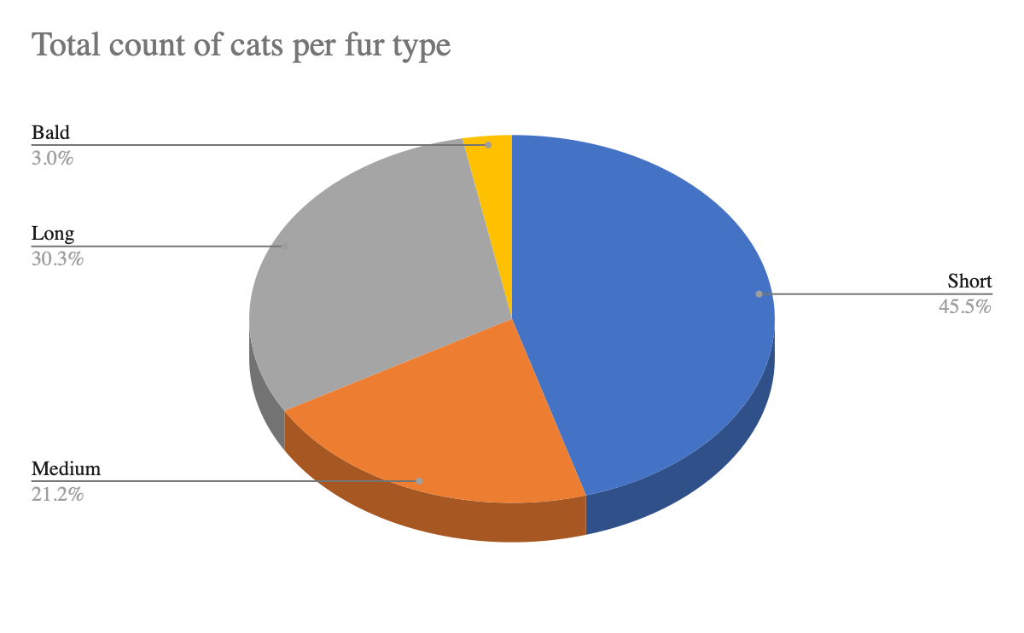
Cat Breeds
Fur type and Temperament
Total count of cats per fur type shows the majority of fur type is presented by “Short” type hear cats.
Mode Temperament Cat Breeds shows the value (Active, Curious, Easygoing, Playful, Calm) that appears most often and prefered in Cat Breeds.
Mode Temperament Cat Breeds | Active, Curious, Easygoing, Playful, Calm

Slide 5
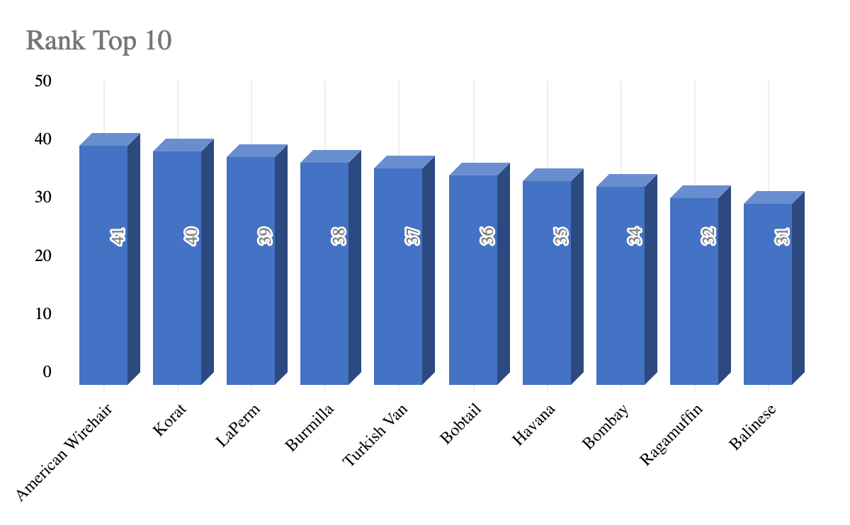
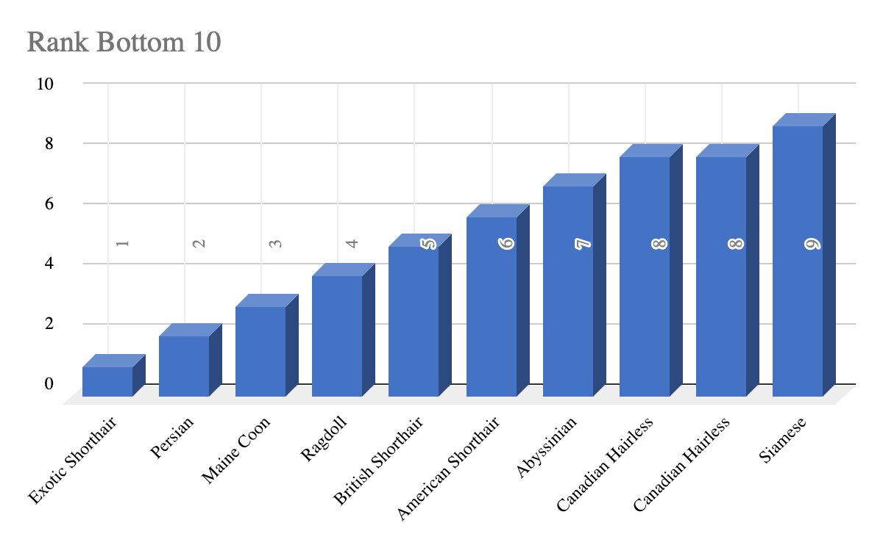
Cat Breeds
Popularity
According to the data the most three popularity cat breeds are “American Wirehair”, “Koral” and “LaPerm”.
Ranking with position ten is “Balinese”.
According to the data the least three popularity cat breeds are “Exotic Shorthair”, “Persian” and “Maine Coon”.
Ranking with position nine is “Siamese”.

Slide 6
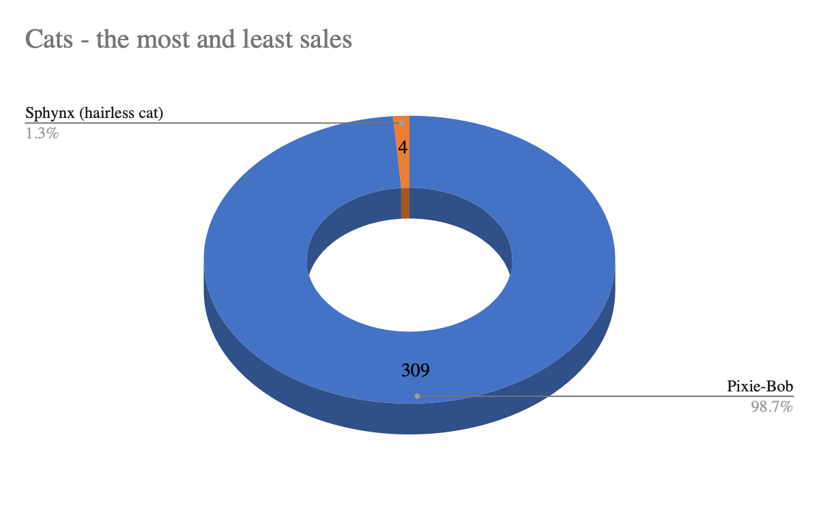
Cat Breeds
Sales
The most sold cat breed is “Pixie-Bob” with value 309.
The least sold cat breed is “Sphynx” with value 4.

Slide 7
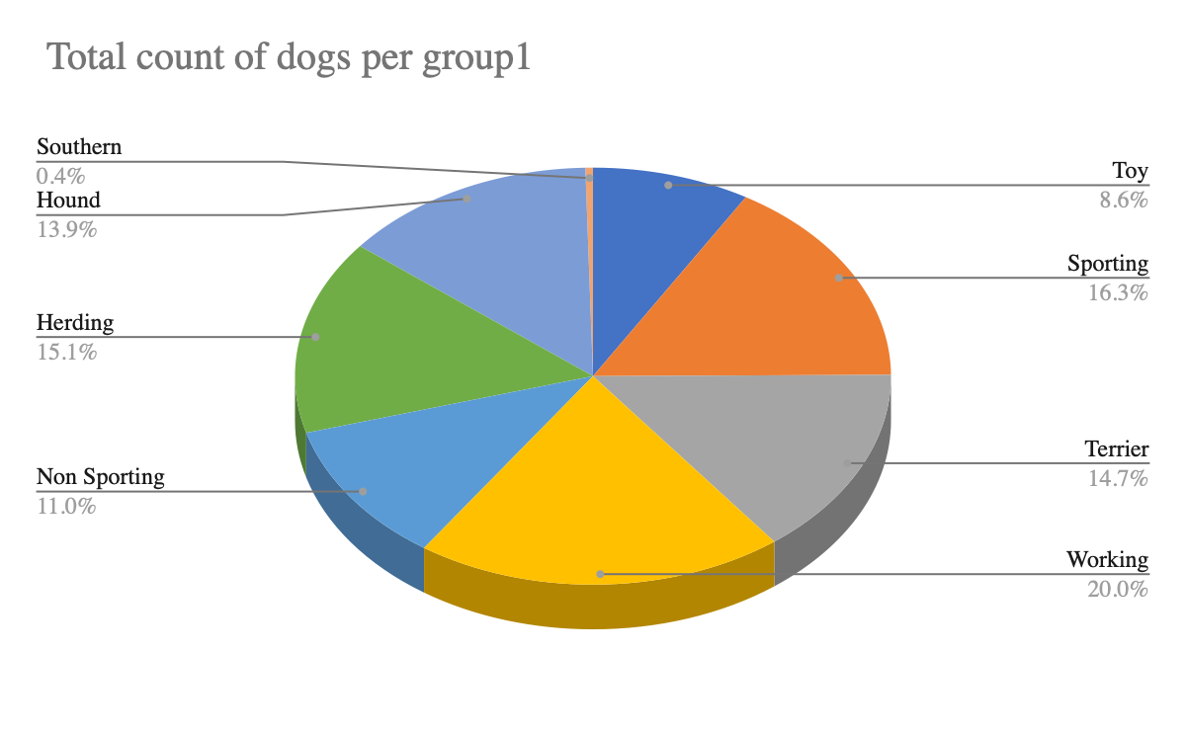
Dog Breeds
Dog breeds categories and Temperament
Total count of dogs per group1 shows the majority of group1 is presented by “Working” dogs.
Mode Temperament Dog Breeds shows the value (Alert, Energetic, Friendly, Independent, Intelligent, Protective) that appears most often and prefered in Dog Breeds
Mode Temperament Dog Breeds | Alert, Energetic, Friendly, Independent, Intelligent, Protective

Slide 8
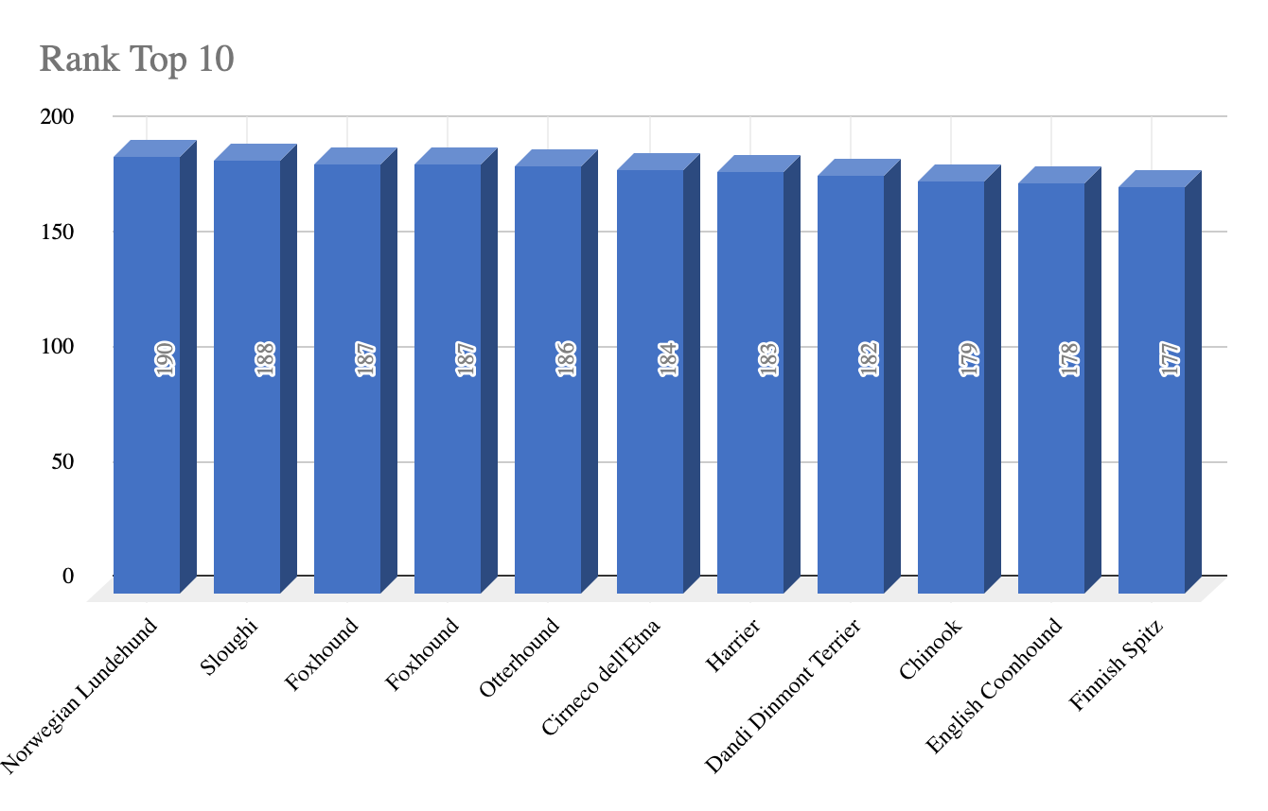
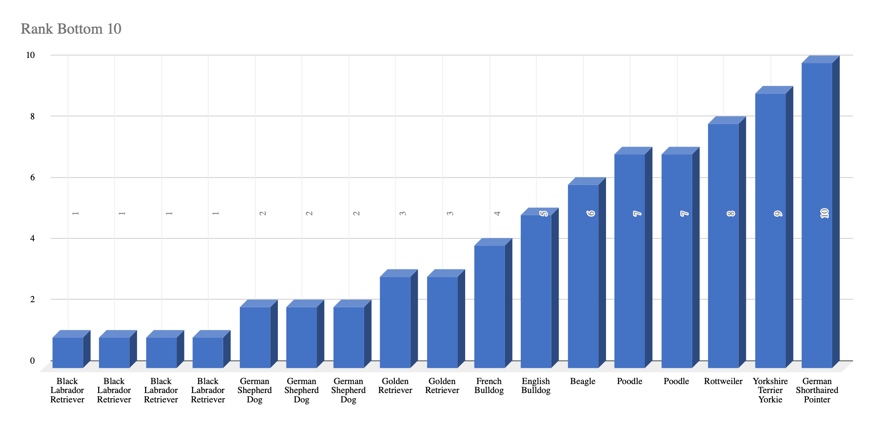
Dog Breeds
Popularity
According to the data the most three popularity dog breeds are “Norwegian Lundehund”, “Sloughi” and “Foxhound”.
Ranking with position ten is “Finnish Spiz”.
According to the data the least three popularity dog breeds are “Black Labrador Retriever”, “German Shepherd Dog” and “Golden Retriever”.
Ranking with position ten is “German Shorthaired Pointer”.

Slide 9
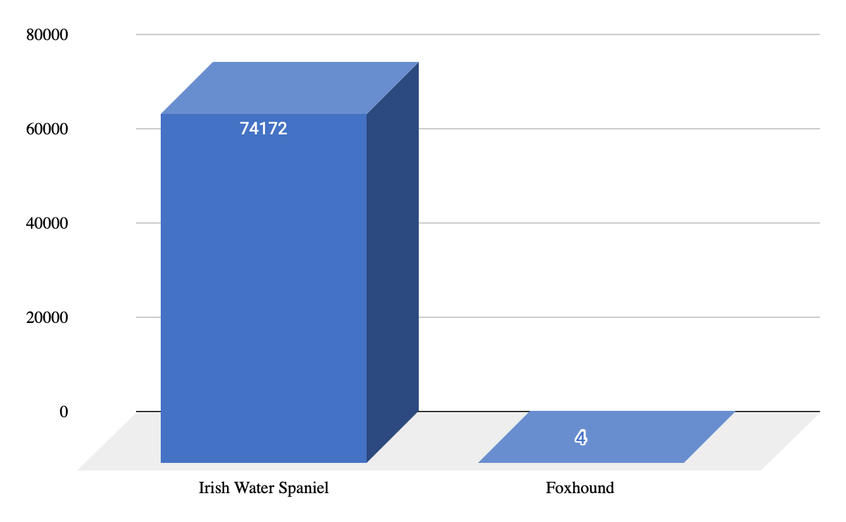
Dog Breeds
Sales
The most sold dog breed is “Irish Water Spaniel” with value 74172.
The least sold cat breed is “Foxhound” with value 4.

Slide 10
Conclusion
The most likely cat breeds temperament are Active, Curious, Easygoing, Playful,Calm and with short hair.In addition temperament for dog breeds are: Alert, Energetic, Friendly, Independent, Intelligent, Protective.
The most popular cat breeds are ”American Wirehair”, “Koral” and “LaPerm”, but the highest sales cat breeds is ”Sphynx”.
The most popular dog breeds are ”Norwegian Lundehund”, “Sloughi” and “Foxhound”, but the highest sales dog breeds is ”Irish Water Spaniel”.

